Slide 1
Relational Calculus

Slide 2
Relational Calculus: It is collective term used for tuple and domain calculus. The relational Calculus is non Procedural Query Language. In this we just have to specify what data is to retrieved not how the data is to be retrieved.

Slide 3
Types of Relational Calculus
Tuple Relational Calculus: It describes the desired information without giving the specific procedure for obtaining that information. The tuple relational calculus is based on specifying a number of tuple variables.
Syntax: {t|COND(t)}
Where t is tuple variable and COND(t) is the a conditional expression involving ‘t’.

Slide 4
For Example:
Retrieve all the tuples of the book relation whose have price greater then 300.
The Relational Calculus query will be:
{t|book(t) and t.price>300}
Retrieve all the title and author of the book having price greater then 300.
{t.title,t.author|book(t) and t.price>300}

Slide 5

These quantifiers are used when we have to bound certain values in the relations.
Existential Quantifier is denoted by Ǝ and Universal quantifier is denoted by

Slide 6
For example:
Consider employee(empno,name,Deptno,DOB,City and Phone)
Department(dno,dname,manager)
Dependent(eno,name,relationship,dob)
Retrieve all the name and city of the employee who works in accounts department
Or

Slide 7
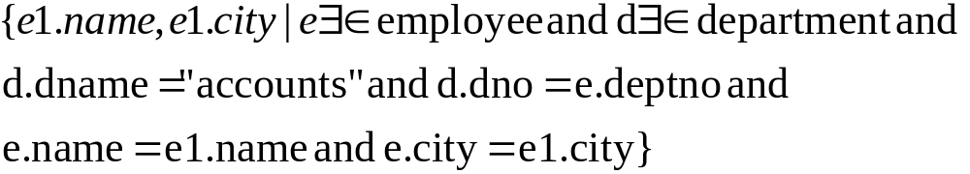
Second way writing the same Query

Slide 8
Examples Based on Tuple Relational Calculus
Consider the following relations:
Course(course_id,Course_name), Assigned-to(teacher _id,course_id), teacher(teacher_id,teacher_name).
Retrieve the teacher_id of all teachers who are teaching course CSE301
Retrieve the teacher_id,teacher-name of all thee teachers who are teaching course_id CSE301.
Get details of teachers who are teaching the course DBMS.

Slide 9
Consider the following relations:
Customer(c_id,c_name,c_address)
Branch(br_name,br_city,assets)
Account(c_id,act_no,br_name,balance)
Retrieve Customer name ,Customer address,Balance who have at least 10 lakh balance in an account.
Br_name ,Balance of the branch where customer have balance less than 1 lakh and branch name starts with a
Customer details who have accounts in branches with asserts more than 50 crores

Slide 10
Consider the following relation:
Employee(Fname,Lname,Emp_id,Dob,Address,gender,salary,Dept_no)
Department(Dname,Dnumber,Mgr_id,Mgr_doj)
Depart_loc(dnumber,dloc)
Works_on(emp_id,proj_no,hours)
Project(pname,pno,ploc,dnum)
Dependent(emp_id,dep_name,gender,bdate,relationship)

Slide 11
Retrieve the name and address of all the employee who works in research department.
For every project located in ‘Delhi', list the project number, the controlling department number, and the department manager's last name, address, and birth date.
Find the names of employees who work on all the projects controlled by department number 5.

Slide 12
Consider the following relations:
Student(ssn, name, address, major)
Course(code, title)
Registered(ssn,code)
Solve the following in Relational Calculus:
List the titles of registered courses
Names of students and the titles of courses they registered to
SSNs of students who are registered for ‘Database Systems’ or ‘Analysis of Algorithms’

Slide 13
Suppliers (Sid, S_name, Address)
Parts (Pid, P_name, Colour)
Catalogue (Sid, Pid, Cost)
1) Find the names of suppliers who supply some red parts.
2) Find the Pid of parts supplied by every supplier at less than INR 500.
3) Find the Sid of suppliers who supply some red or green part.

Slide 14
Domain Calculus
In Domain calculus each field have there own domain that can be represented by the variables. While writing a query in domain calculus
If there are more then one table then only those domains are bounded which have some condition associated with it and who are not present at the left side of the bar rest are free variables.
If only one table is there then only fields domains that are to be retrieved are free rest are bounded in domain calculus query.

Slide 15
Writing Query in Domain Calculus:
Consider employee(empno,name,Deptno,DOB,City and Phone)
Department(dno,dname,manager)
Dependent(eno,name,relationship,dob)
Retrieve all the name and city of the employee who works in accounts department
{be|(Ǝc)(Ǝr)(Ǝs)employee(abcdef) and department(rst) and c=r and s=‘accounts’}
Or

Slide 16
Examples based on domain calculus
Consider the following relations:
Course(course_id,Course_name), Assigned-to(teacher _id,course_id), teacher(teacher_id,teacher_name).
Retrieve the teacher_id of all teachers who are teaching course CSE301
Retrieve the teacher_id,teacher-name of all thee teachers who are teaching course_id CSE301.
Get details of teachers who are teaching the course DBMS.

Slide 17
Consider the following relation:
Employee(Fname,Lname,Emp_id,Dob,Address,gender,salary,Dept_no)
Department(Dname,Dnumber,Mgr_id,Mgr_doj)
Depart_loc(dnumber,dloc)
Works_on(emp_id,proj_no,hours)
Project(pname,pno,ploc,dnum)
Dependent(emp_id,dep_name,gender,bdate,relationship)

Slide 18
Retrieve the name and address of all the employee who works in research department.
For every project located in ‘Delhi', list the project number, the controlling department number, and the department manager's last name, address, and birth date.
Find the names of employees who work on all the projects controlled by department number 5.

Slide 19
Employee(person_name,street,city)
Works(person_name,Company_name,salary)
Company(Company_name,City)
Manages(person_name,Manager_name)
Find the names of all employees who works for”First Bank Corporation”.
Find the names and cities of residence of all employees who work for ”First Bank Corporation”.
Find the names,street addresses,and city of residence of all employees who work for ”First Bank Corporation” and earn more than 10000.

Slide 20
Find all the employee who live in same city as that in which the company for which they work is located.
Find all the employee in database who do not work for ”First Bank Corporation”.

